Slide 1
Business and Industrial Economics
Prof. Luca Grilli
Innovation and technological change: The legacy of Schumpeter (continued) & Market structure and innovation

Slide 2

Economic background (milestones)
The legacy of Schumpeter

Slide 3
A Taxonomy of Innovations
Product versus Process Innovations
Product Innovations refer to the creation of new goods and new services, e.g., Smart TVs and mobile phones
Process Innovations refer to the development of new technologies for producing goods or new ways of delivering services, e.g., robotics and CAD/CAM technology.
Radical (disruptive) versus incremental (gradual) Innovations (often PRODUCT but also PROCESS)
Technological breakthrough that might create new markets
Small adjustments over existing products (or processes)
Drastic versus Non-Drastic Innovations (PROCESS)
Drastic innovations have such great cost savings that they permit the innovator to price as an unconstrained monopolist
Non-drastic innovations give the innovator a cost advantage but not unconstrained monopoly power

Slide 4
Drastic versus Non-Drastic Innovations
Suppose that demand is given by: P = 120 – Q and all firms have constant marginal cost of c = $80
Let one firm have innovation that lowers cost to c_{M} = $20
This is a Drastic innovation. Why?
Marginal Revenue curve for monopolist is: MR = 120 – 2Q
If c_{M} = $20, optimal monopoly output is: Q_{M} = 50 and P_{M} = $70
Innovator can charge optimal monopoly price ($70) and still undercut rivals whose unit cost is $80.
If cost fell only to $60, innovation is Non-drastic.
Marginal Revenue curve again is: MR = 120 – 2Q
Optimal Monopoly output and price: Q_{M} = 30; P_{M} = $90
However, innovator cannot charge $90 because rivals have unit cost of $80 and could under price it. Innovator cannot act as an unconstrained monopolist: the best innovator can do is to set price just under $80 and supply all 40 units demanded.

Slide 5
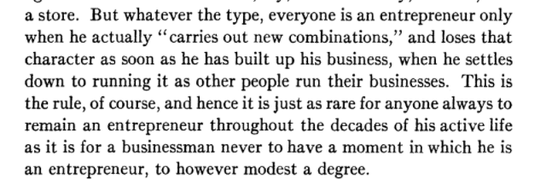
Schumpeter Mark I
The paleo-schumpeterian entrepreneur:
The theory of economic development (1912-34)
Individual capable of transform an invention into an innovation through an entrepreneurial act.
The Theory of Economic Development, p. 78

Slide 6
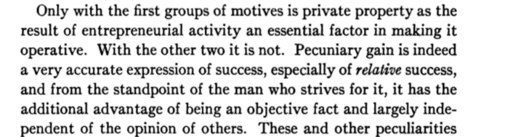
Schumpeter Mark I
Incentive: more than just economics but economics play a very important role:
1. “The dream and will to found a private kingdom”
“There is the will to conquer: the impulse to ﬁght, to prove oneself superior to others, to succeed for the sake, not for the fruits of success, but of success itself. From this aspect, economic activity becomes akin to sport”
“Finally, there is the joy of creating, of getting things done”
The Theory of Economic Development, pp. 93-94

Slide 7
Schumpeter Mark I
Expectation of supra normal profit of key importance. Be the “first” (and only) in the market increases these expectations.
Absence of these extra-profits as a pay-off of innovative entrepreneurial activity = low innovation rate.
If instantaneous imitation = no innovation.
In order to stimulate innovation, there should not be instantaneous imitation (Patents do play a role on this, even if Schumpeter never put a strong emphasis on IPR protection).
Over time the “entrepreneurial profit” of the innovator is eroded by competition from imitators.
The process of “creative destruction”: competition through innovation results in high level of dynamic efficiency (and high social mobility).
INNOVATION MAINLY FROM NEW FIRMS

Slide 8
Schumpeter Mark II
The neo-schumpeterian vision:
Capitalism, socialism and democracy (1942)
High innovative performance of the capitalist system, characterized by the presence of large oligopolistic companies which has reduced innovation to “routine” with no need of “leadership”:
“Innovation itself is being reduced to routine. Technological progress is increasingly becoming the business of teams of trained specialists who turn out what is required and make it work in predictable ways. The romance of earlier commercial adventure is rapidly wearing away, because so many more things can be strictly calculated that had of old to be visualized in a flash of genius.”
“Thus, economic progress tends to become depersonalized and automatized. Bureau and committee work tends to replace individual action […]. Rationalized and specialized office work will eventually blot out personality, the calculable result, the “vision”. The leading man no longer has the opportunity to fling himself into the fray. He is becoming just another office worker—and one who is not always difficult to replace.”
The obsolescence of the entrepreneurial function (Chapter XII – I, p. 133-137)

Slide 9
Schumpeter Mark II
Key role of large scale techno-structures (R&D labs) in the innovative process: R&D benefits from economies of scale (and scope).
(Severe) capital market imperfections especially for new firms
INNOVATION MAINLY FROM BIG COMPANIES (IN CONCENTRATED MARKETS)
“As soon as we go into details and inquire into the individual items in which progress was most conspicuous, the trail leads not to the doors of those firms that work under conditions of comparatively free competition but precisely to the doors of the large concerns—which, as in the case of agricultural machinery, also account for much of the progress in the competitive sector—and a shocking suspicion dawns upon us that big business may have had more to do with creating that standard of life than with keeping it down.” (p. 82)

Slide 10
Since Schumpeter the debate revolves around
PUBLIC POLICY
Mkt structure
Innovation

Slide 11
1° Question: Which market structure favors innovation?
Schumpeterian hypothesis (see Geroski 1990, Oxford Economic Papers, 42, 586-602)
“Monopoly deadweight loss is the price that must be paid for high level of innovative activity” (see Geroski 1990, Oxford Economic Papers, 42, p. 586)
Anticipated and Actual Monopoly Power
Anticipated monopoly power refers to an innovator's ability to enjoy the full benefits of its research by preventing imitation (SM1)
Actual monopoly refers to the current monopoly position of a firm. This position can have positive direct (and also indirect) effects on innovative activity (SM2):
“[…] Monopolists may be possessors of various types of material advantages. In particular, high current period profits generated by the exercise of actual monopoly power may enable a monopolist to hire more highly qualified personnel, and may provide internal finance which facilitates a rapid response to events and weakens the firm's reliance on costly external finance.” (Geroski 1990, p. 587)

Slide 12
1° Question: Which market structure favors innovation?
Arrow (1962) vs. Schumpeter (1942):
Monopoly provides less incentive to innovate than competitive industry because of the “Replacement Effect”.
Note:
Views are not necessarily at odds: incentives to invest in R&D can be different from capabilities to do so.
Mixed evidence:
- inverted U-relationship between intensity of competition and innovation
- radical innovation introduced by new firms (SM1)
- incremental innovation more by large companies (SM2)
[Big Data and AI may modify to some extent these stylized empirical facts]

Slide 13
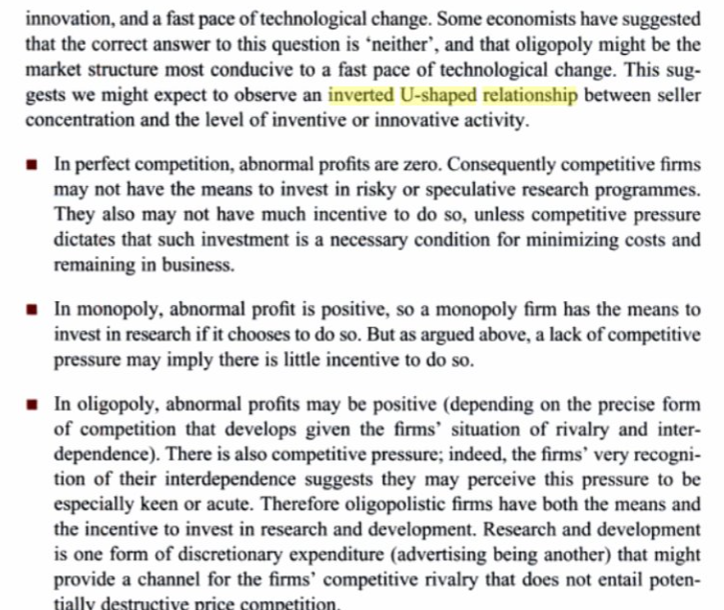
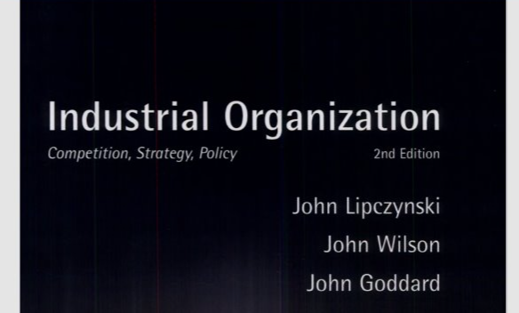
One simple explanation of the inverted U-shaped relationship
p. 503

Slide 14

2° Question: To what extent “innovation should affect market structure”?
Appropriability: ability of the innovator to capture the benefits engendered by its own innovation (to the detriment of other potential imitating firms).

Slide 15
Appropriability instruments
Obtained exogenously (formal mechanisms) through regulation of property rights: to the innovator is assigned the right to exclude others to make unauthorized use of the innovation (temporary monopoly).
Obtained endogenously (informal mechanisms) by an innovative firm through the establishment of strategic barriers to imitation.
Practical problems of patents:
Diffusion of valuable information (spillovers) relating to the technology which may lead to “inventing around”.
“Contractual” incompleteness and difficult enforcement.
Main alternative strategic mechanisms to assure appropriability:
Secrecy (e.g. Coca Cola formula; or see this scene from the movie Flash of Genius: https://www.youtube.com/watch?v=IKMELT29qL4);
Lead time (Intel microprocessor)
Complementary investments (in brand, sales & distribution and customer care, e.g. Nespresso).

Slide 16
Intellectual Property Rights
Historically, 2 different views on patent rationale, their lenght, breadth and enforcement:
Incentives View
Openness View

Slide 17

Intellectual Property Rights
This debate has been historically solved much more in favour of the incentives view rather than the openness view
But the openness view has certainly gained some momentum over the past few years

Slide 18
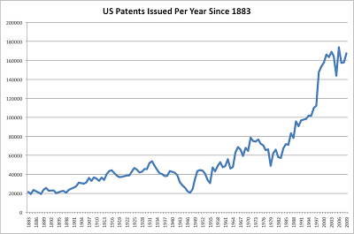
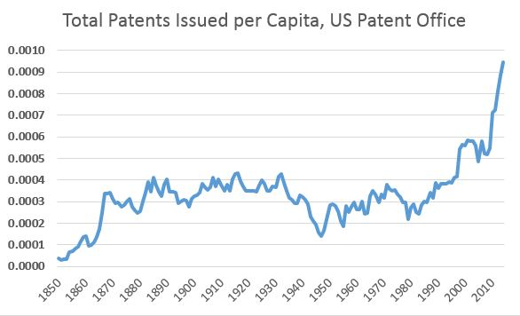
N° of patents

Slide 19
On the use of appropriability tools
Cohen, Nelson and Walsh (2000), Protecting their intellectual assets: Appropriability conditions and why US manufacturing firms patent (or not), NBER working paper, n. 7752.
- 1478 US manufacturing firms with R&D expenses
Firms were asked to report the percentage of their product and process innovations for which each appropriability mechanism had been effective in protecting the “firm’s competitive advantage from those innovations” during the prior three years.
Five response categories were: 1.) less than 10%; 2.) 10% through 40%; 3.) 41% through 60%; 4.) 61% through 90%; and 5.) greater than 90%.

Slide 20
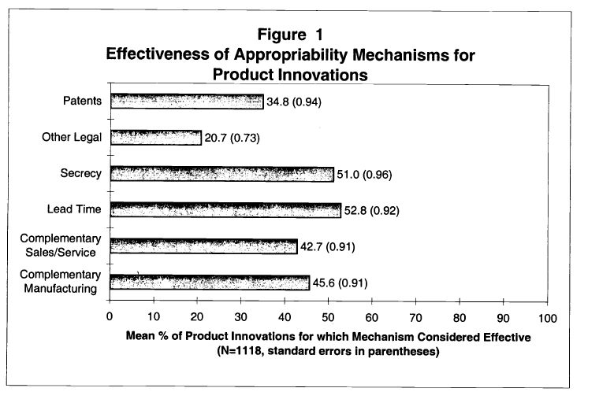
Cohen, Nelson and Walsh (2000)

Slide 21
Things do not change (and are probably reinforced) looking more recently to start-ups in other geographical contexts (Italy)
Table 4. Mutual correlation
Variable | (1) | (2) | (3)
(1) IP protection | 1.00
(2) Formal IP protection | 0.50 | 1.00
(3) Informal IP protection | 0.87 | 0.32 | 1.00

Slide 22
PATENT might not be used to defend own innovation but rather for preventing others from innovate

Slide 23
Cumulativeness & Complexity of innovation
In many sectors (like for example ICT) technologies are becoming more and more cumulative & complex: the number of patents on the same product is increasingly growing
Eg. n° of essential patents to protect the 2 main standards (WCDMA and CDMA2000) for 3G mobile phone was estimated to be 7,796 (Goodman & Myers, IEEE WirelessCom, June 13, 2005). ETSI (European Telecommunications Standards Institute) report globally c.a. 23.500 essential patents for GSM (2° generation) and 3G (UMTS standard). Figures about 4G mobile phone standards (LTE/LTE-A) and 5G are even much (much) higher!!!!!
More generally we observe more and more PATENT THICKETs

Slide 24
Cumulativeness & Complexity of innovation
Difficult (in some cases almost impossible) that a single firm owns all IPRs on these different technological parts that uses (or wants to use). Thus, having a patent on a specific and possibly key component of a technology might lead to:
block others’ innovation (“blocking patents”, Heller and Eisenberg 1998, Science).
Give more bargaining power in a licensing transaction (what Jaffe e Lerner (2004) define as “Rembrandts in the Attic”).
There are of course potential endogeneous solutions (e.g. Cross-licensing; Patent pools; Standard setting mechanisms) but these may not always work effectively.

Slide 25
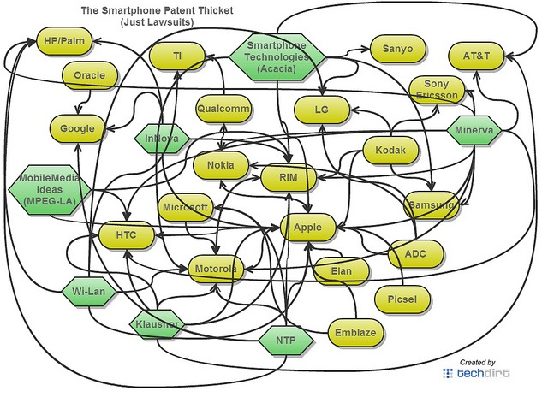
Patent litigations

Slide 26
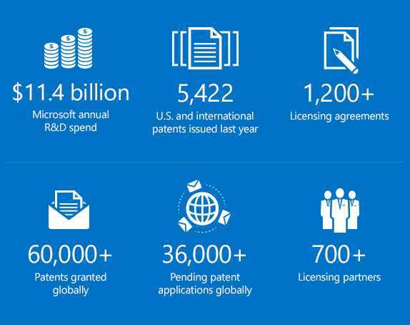
Microsoft example (from its website)

Slide 27
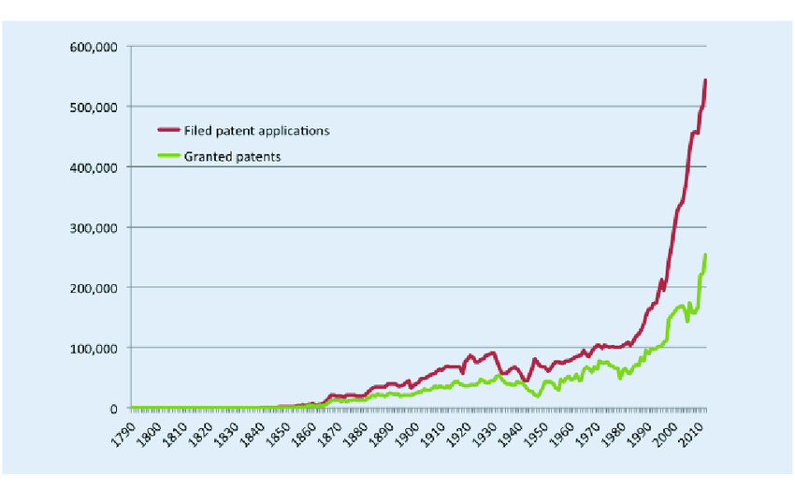
Number of patent applications received and patents granted by the
US Patent and Trademark Office, 1790-2010
ITU 2014, “Understanding patents, competition & standardization in an interconnected world”.

Slide 28
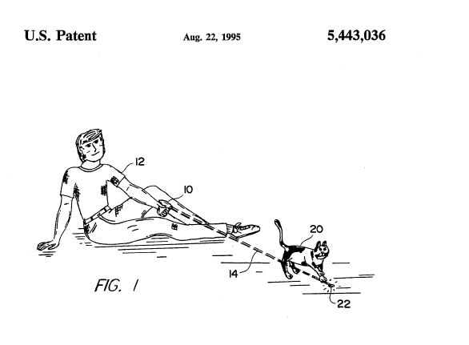
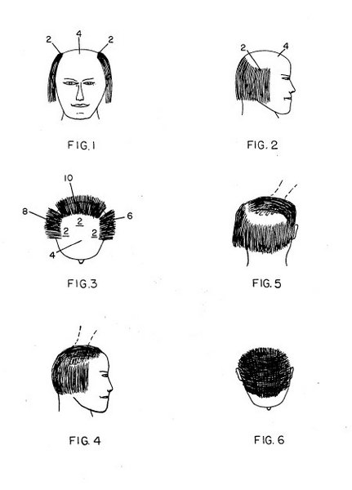
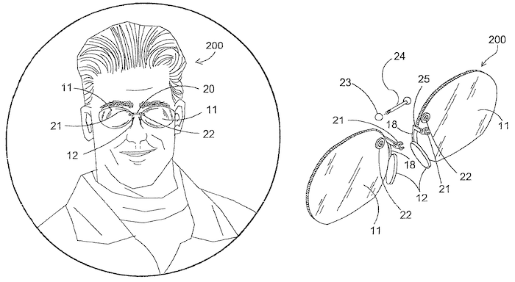
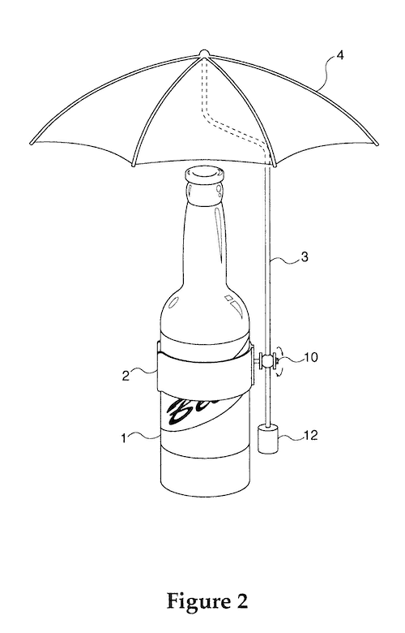
Weak patents
4,022,227: Method of concealing partial baldness (1977)
5,443,036: Method of exercising a cat (1995)
7,066,592: Frameless glasses attaching to body (2004)
6,637,447: Beerbrella (2001)

Slide 29
Also weak patents can be used for offensive strategic purposes
From Patently absurd, Gary Rebeck 2002, June 24, Forbes:
[…] My own introduction to the realities of the patent system came in the 1980s, when my client, Sun Microsystems--then a small company--was accused by IBM of patent infringement. Threatening a massive lawsuit, IBM demanded a meeting to present its claims. Fourteen IBM lawyers and their assistants, all clad in the requisite dark blue suits, crowded into the largest conference room Sun had. The chief blue suit orchestrated the presentation of the seven patents IBM claimed were infringed, the most prominent of which was IBM's notorious "fat lines" patent: To turn a thin line on a computer screen into a broad line, you go up and down an equal distance from the ends of the thin line and then connect the four points. You probably learned this technique for turning a line into a rectangle in seventh-grade geometry, and, doubtless, you believe it was devised by Euclid or some such 3,000-year-old thinker. Not according to the examiners of the USPTO, who awarded IBM a patent on the process.

Slide 30
After IBM's presentation, our turn came. As the Big Blue crew looked on (without a flicker of emotion), my colleagues--all of whom had both engineering and law degrees--took to the whiteboard with markers, methodically illustrating, dissecting, and demolishing IBM's claims. We used phrases like: "You must be kidding," and "You ought to be ashamed." But the IBM team showed no emotion, save outright indifference. Confidently, we proclaimed our conclusion: Only one of the seven IBM patents would be deemed valid by a court, and no rational court would find that Sun's technology infringed even that one. An awkward silence ensued. The blue suits did not even confer among themselves. They just sat there, stonelike. Finally, the chief suit responded. "OK," he said, "maybe you don't infringe these seven patents. But we have 10,000 U.S. patents. Do you really want us to go back to Armonk [IBM headquarters in New York] and find seven patents you do infringe? Or do you want to make this easy and just pay us $20 million?" After a modest bit of negotiation, Sun cut IBM a check, and the blue suits went to the next company on their hit list.

Slide 31
I personally agree on the words of Penrose 1951:
Conclusion
All these arguments have reinforced the “openness view” and also led to radical positions (e.g. see Boldrin and Levine pamphlet (2008) Against Intellectual Monopoly). But, admittedly, the debate is still very lively, see the recent book by Daniel Spulber, 2021, The Case for Patents)
“If national patent laws did not exist, it would be difficult to make a conclusive case for introducing them; but the fact that they do exist shifts the burden of proof and it is equally difficult to make a really conclusive case for abolishing them.”

Slide 32
References
Cabral, Introduction to Industrial Organization (2000), I edition, chapter 16 and/or Introduction to Industrial Organization (2018), II edition, chapter 15
Further reading:
Comino, Manenti, Industrial Organization of High-technology markets, chapter 6.
Pepall, Richards, Norman, Industrial Organization: contemporary theory and empirical applications, chapter 18.

